Slide 1


Object Detecting
Name: Md. Adnan Shariar
ID: 1521948042
Sec- 02
Course-Cse465

Slide 2
Introduction
Object detection is a computer technology related to computer vision and image processing that deals with detecting instances of semantic objects of a certain class (such as humans, buildings, or cars) in digital images and videos.
Object detection generally fall into either machine learning-based approaches or deep learning-based approaches. For Machine Learning approaches, it becomes necessary to first define features using one of the methods below, then using a technique such as support vector machine (SVM) to do the classification. On the other hand, deep learning techniques are able to do end-to-end object detection without specifically defining features, and are typically based on convolutional neural networks (CNN).

Slide 3
Model
In a CNN, convolution layers play the role of feature extractor
And CNN is an artificial neural network that is so far been most popularly used for analysis images.

Slide 4

Data-Set
I have downloaded the Object Detection data-set from Kaggle. Dataset contain more than 28000 images.
The training set consists of 300 examples.

Slide 5
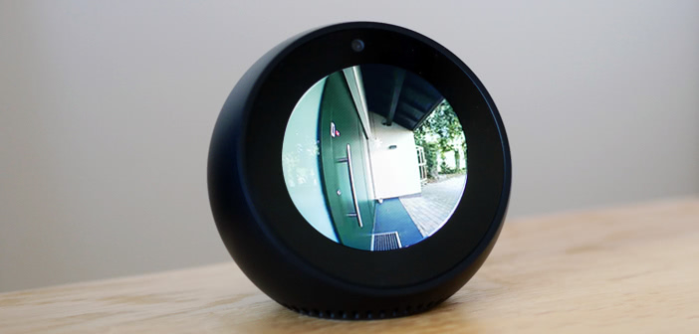

Tools & Libraries
Anaconda 3 setup for Python
Tensorflow (as Backend)
Spyder Environment
OpenCV
Keras for running CNN model
Cvlib
Matplotlib
Glob(import pic from dataset)

Slide 6
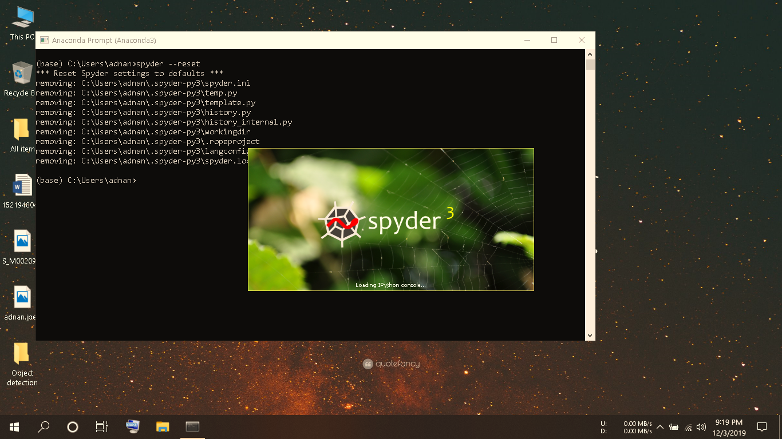
Training and Running Model:

Slide 7
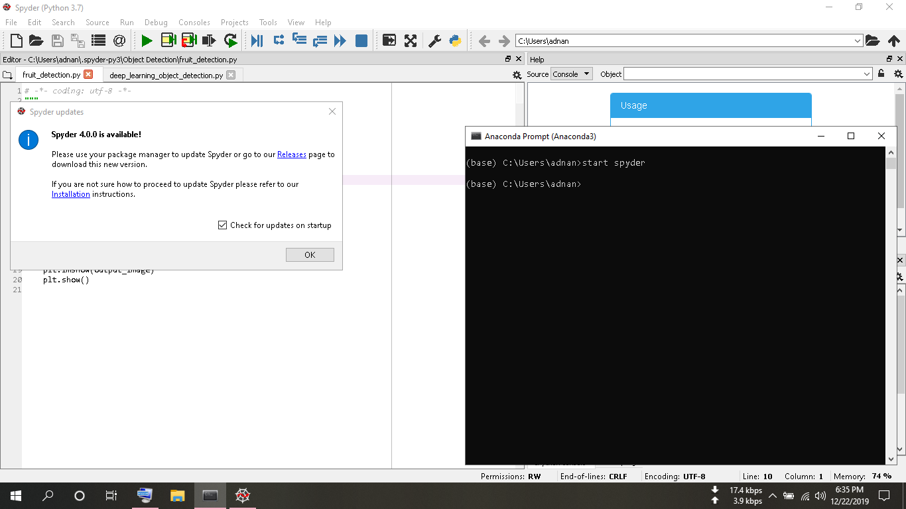
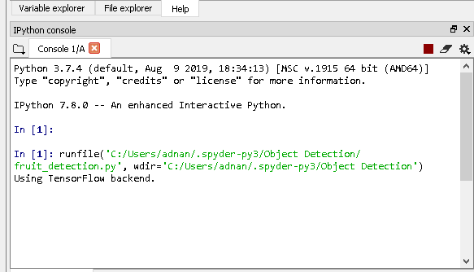

Slide 8
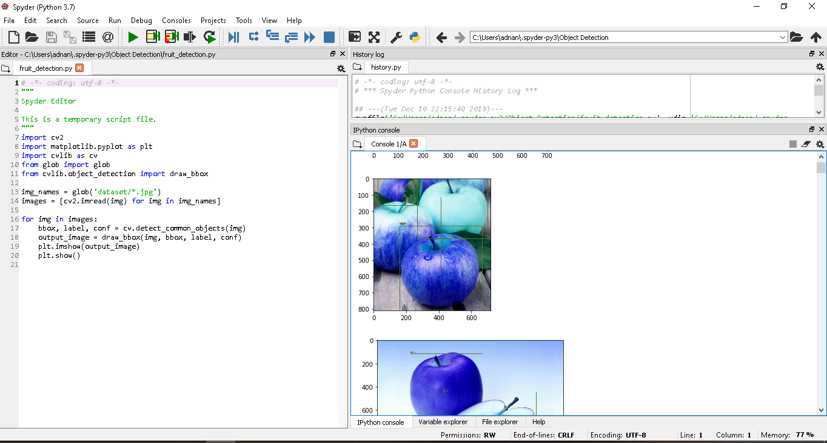

Slide 9
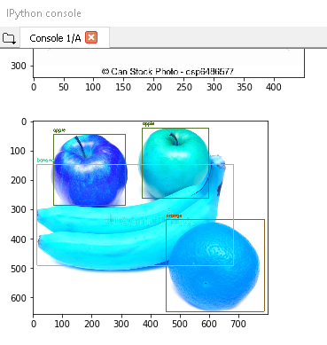
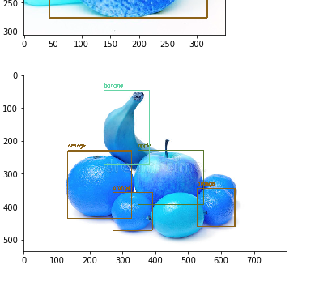
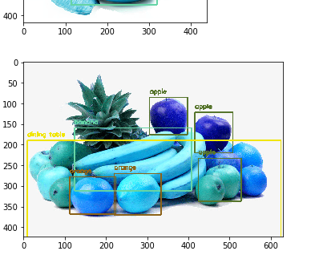
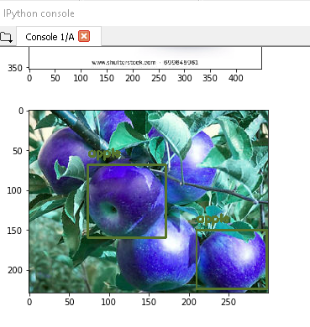
CONSOLE GENERATED Output

Slide 10


